Slide 1


SAP UI5 & FIORI with OData TRAINING using BAS
Sakshi Gupta
Day – 7

Slide 2

Agenda – Day 7
Introduction to List controls in SAP UI5
Types of List in UI5
Creating model in Manifest.json
Search Functionality
List Modes and Grouping
Header and Footer Toolbar
Worklist Application
Split App Container
Loading Empty view at Start
Performance Issues in our app

Slide 3
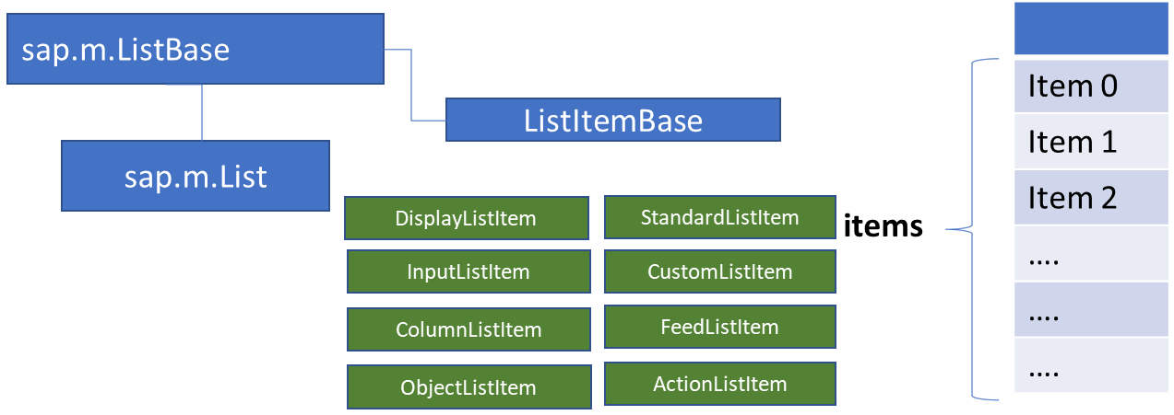
List Control
The list contains various list items. These items can be of various types depending on the use case and on the content they have. SAPUI5 already provides the most common list items in SAP Fiori in the form of controls, although custom list items can also be created if necessary.
Reference: https://sapui5.hana.ondemand.com/#/entity/sap.m.List
A List control is a single column table with multiple items inside. We will have a list header and items as aggregation.

Slide 4
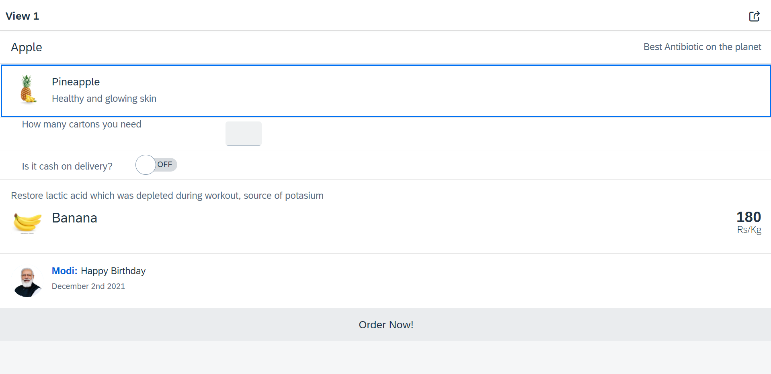
Hands – on: List Controls in UI5
Now we will add some basics list controls in the View1 of our application.
Code Links:
View1.view.xml

Slide 5
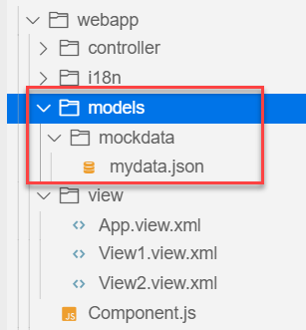
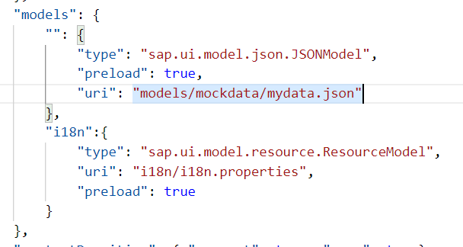
Hands – on: Models in manifest.json
Now we want to bind our list control to a model to show the multiple records using the list control.
For this first we need a file with some demo data related to the fruits, so we have created a file which has three entity sets:
fruits – name, color, type (neutral, citrus, alkaline),price, healthBenefit, unit, status (available, discontinued, out of stock), image (url from google) – 20
cities – name, state, famousFor, population – 10
supplier – name, city, country, contactPerson, phone, email, sinceWhen – 10
Now we will create a models folder in the webapp and in the models folder we will create a folder named mockdata, we will put our json file in this folder.
Code Link:
manifest.json
mydata.json
View1.view.xml

Slide 6
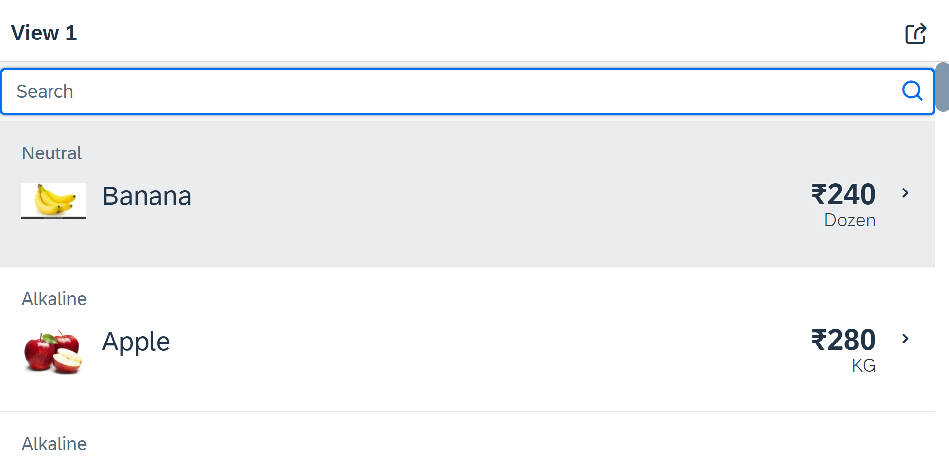
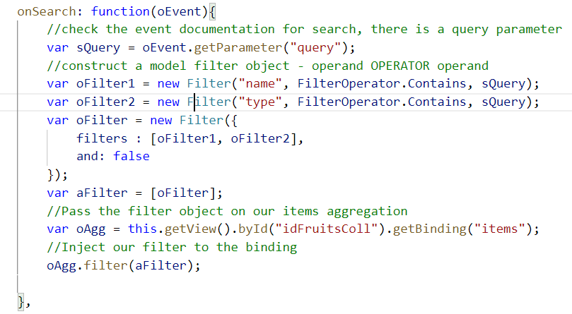
Hands – on: Search Functionality
Nowadays we come across many web pages that provide data in the form of lists or tables. These lists are enabled with search functionality, i.e., as the user types in into the search field and press enter then the data in the list is filtered according to the value in search field.
Code Link:
View1.view.xml
View1.controller.js

Slide 7
List Modes
The mode property defines the appearance of the left area of a list item.
Lists have properties and events and they contain list items that inherit from sap.m.ListItemBase, which provides navigation, selection and event features.
Delete
SingleSelect
01
04
only one list item can be deleted via provided delete button
Right-positioned single selection mode (only one list item can be selected).
01
04
MultiSelect
You can edit this text
SingleSelectLeft
02
05
02
more than one list item can be selected
05
Left-positioned single selection mode (only one list item can be selected).
03
06
None
03
06
SingleSelectMaster
no selection
Selected item is highlighted but no selection control is visible (only one list item can be selected).

Slide 8
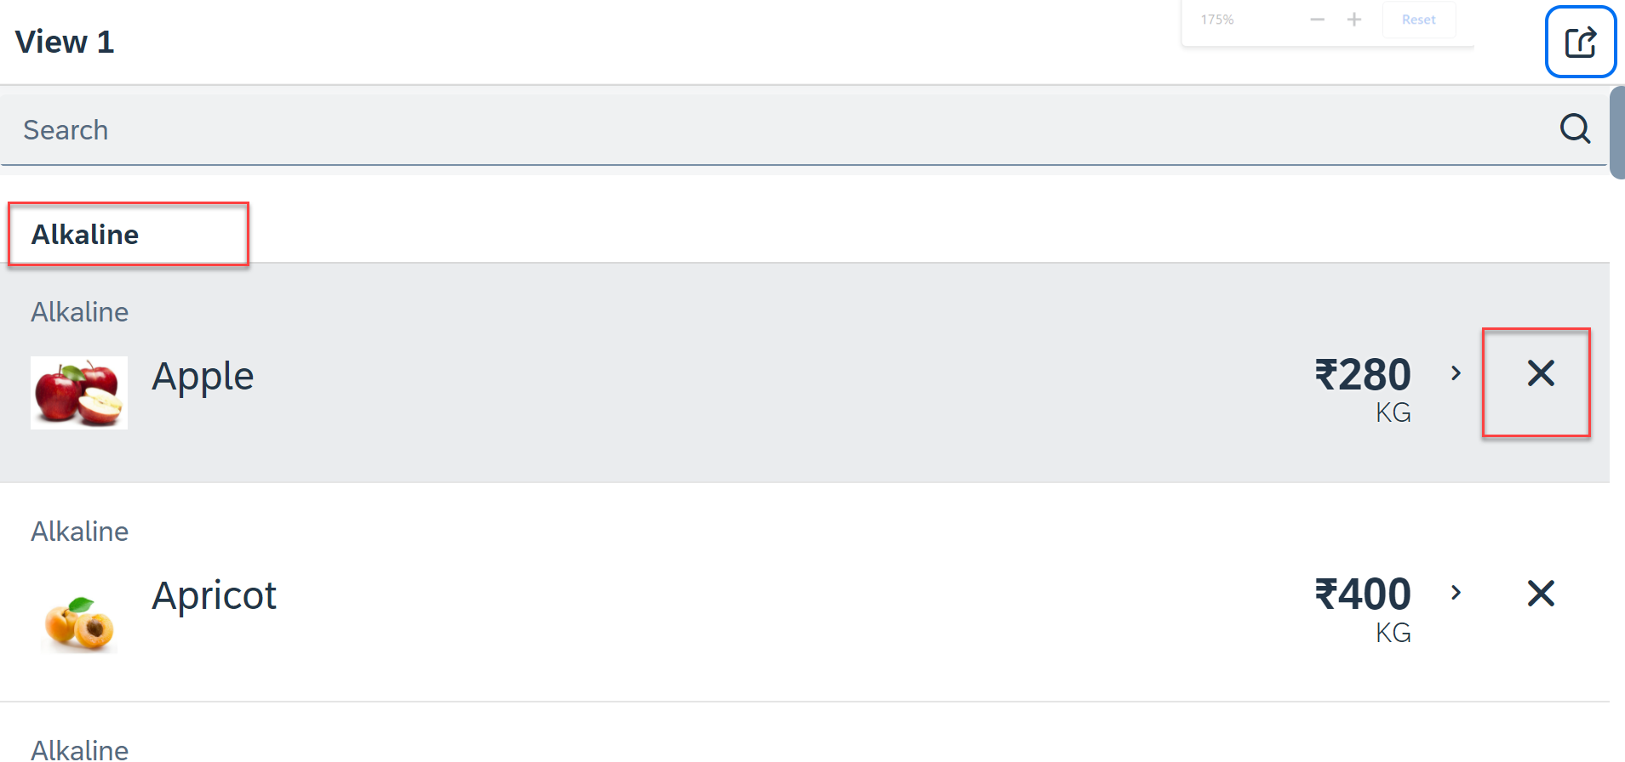
Hands – on: List modes and Grouping
Now we will look at the different type of List mode provided by the UI5.
Along with that we will Implement the Press event, Selection change and Delete Event in the List Control.
Also we will Group the data according to the type of Fruit.
Code Link:
View1.view.xml
View1.controller.js

Slide 9
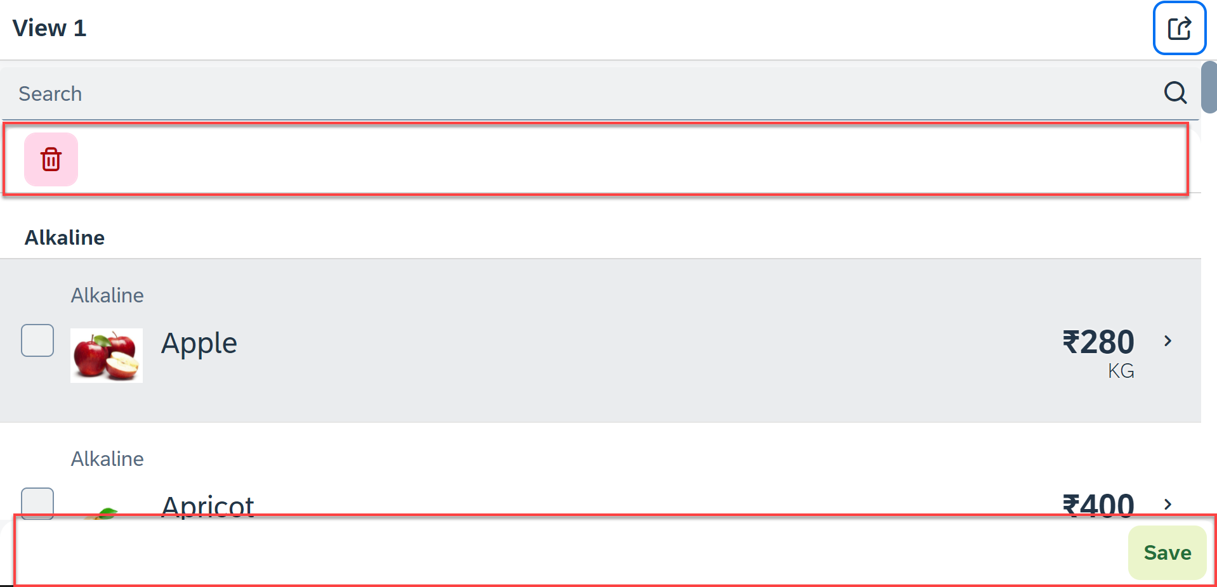
Hands – on: Header and Footer Toolbar
Now we will add a Header Toolbar to the list control and in that we will add a delete button to delete multiple items from the List.
We will also add a Footer toolbar to the page control and in that we will add a save button on press of the save button a alert will be shown to the user.
Code Link:
View1.view.xml
View1.controller.js

Slide 10
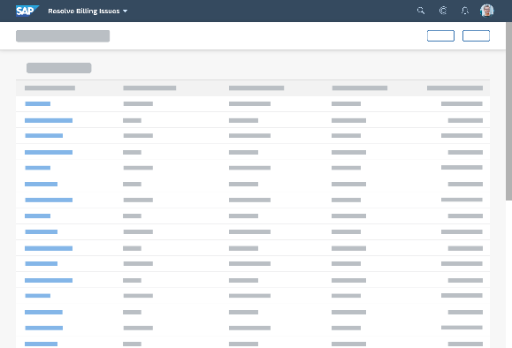
Introduction to Worklist Application
A worklist displays a collection of items a user needs to process. Working through the list usually involves reviewing details of the items and taking action. In most cases, the user has to either complete a work item or delegate it.
When to use:
Users have numerous work items and need to decide which ones to process first.
You want to give users a direct entry point for taking action on work items.
Users need to work with multiple views of the same content (for example, items that are “Open”, “In Process”, or “Completed”). You want to offer tabs for switching between views.
Detail View
List Page

Slide 11
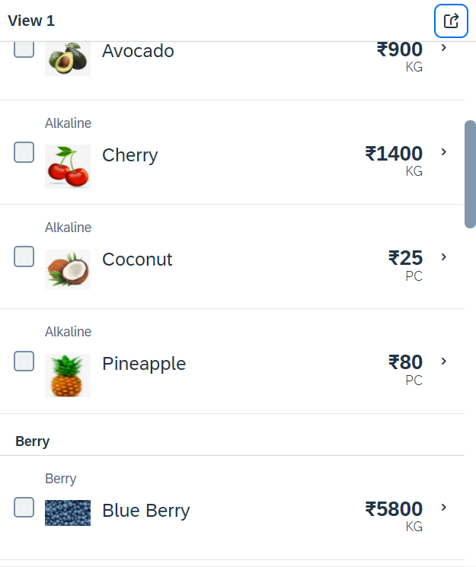
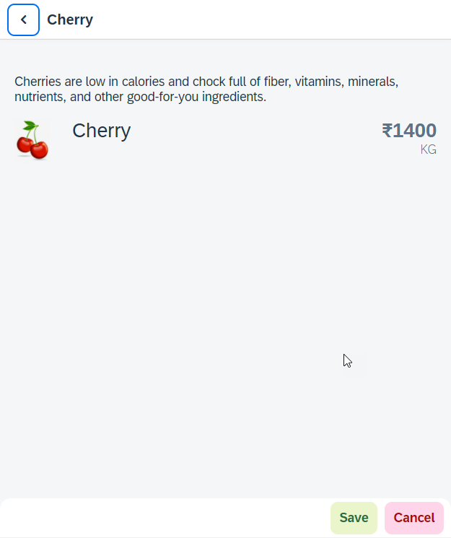
Hands – on: Worklist App
Now we will make our application a worklist app. On selecting the fruit on the View1 navigate to the View2 and show the details of that the selected fruit on it.
For this we have to modify the onSelectItem Function to get the path of the selected item and pass it in the onNext function.
Code Link:
View1.view.xml
View1.controller.js
View2.view.xml

Slide 12
SplitApp Container Control
A split app container control will divide our app into 2 parts, 1st is called master section and 2nd is called detail section. It is used to fully optimize the screen width for desktop apps.
SplitApp Container
masterPages
detailPages
App Container
View1
View2
View1
View2

Slide 13
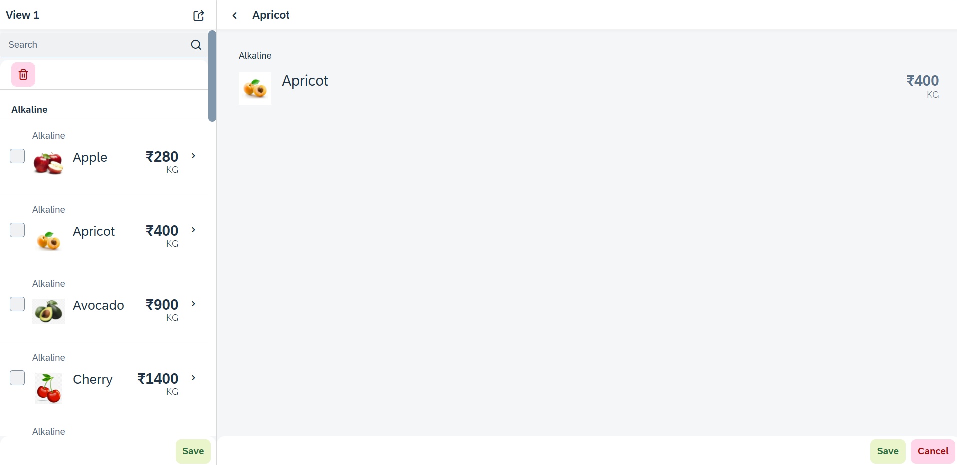
Hands – on: SplitApp (Mater Detail App)
Now we will convert our worklist app to a master detail application.
Once we change the app container, we have to change the method of getting the view object in onNext function.
Code Links:
App.view.xml
Component.js
View1.controller.js

Slide 14
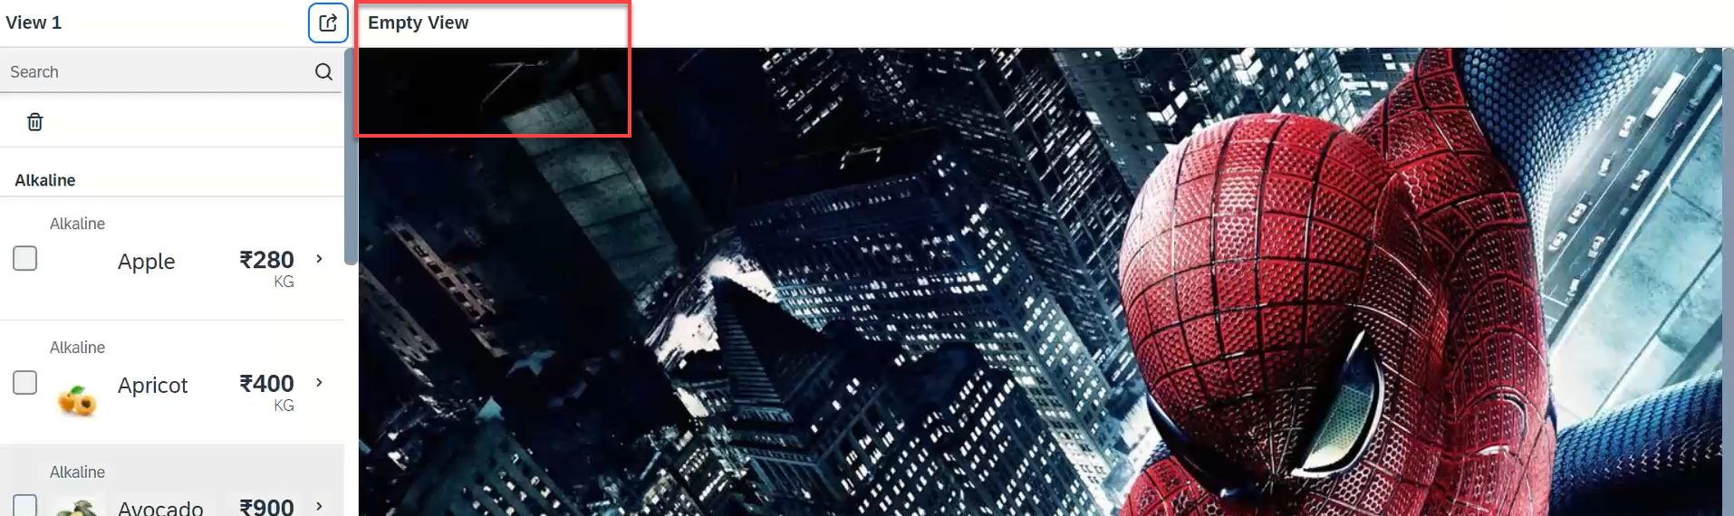
Hands – on: Empty View at start
Now we want to load an Empty view in the detail section when our application starts.
To do this first we need to create one Empty View and Empty controller.
After we need to add the Empty view to the Split App container in the Component.js file.
oAppCon.addMasterPage(oView1).addDetailPage(oEmpty).addDetailPage(oView2);
Code Link:
Empty.view.xml
Empty.controller.js
Component.js
View1.controller.js
This view will be loaded by default

Slide 15

Performance Issues in our Fiori App
We have used sap.ui.view API to create the object of the view, but it seems that the API is obsolete. Then what is the right way to instantiate our view?
All the view objects are instantiated when app starts, whether we want or not. If user does not navigate to a view, still the view object is getting created. This is a misuse of computation power and slow down our app when number of views are increased/high.
For each view, we are writing more and more code to create object, multiple developers will add this code in different place, because of this the maintenance will be come very expensive even the handover will be very hard.
The browser navigation button (back) is not working properly.
When the refresh of app happens, the application should restore the state of the UI. It should not start all over again. So user will not frustrate applying all the filters again.
When we take a URL of the page and share with colleagues/friends/family, when they open same URL, Eventually they should see the same state of application what I see. Basically we should restore the state of UI as it is in our system.
Router

Slide 16

End of Day 7

Slide 17

Questions

Slide 18

Sakshi Gupta

Slide 19


We’re committed to empower you to be
Most Desirable Resource
through powerful training solutions.
We build the workforce of the future.
250+
Corporate Clients
30,000+
Learners Trained
25000+
Learners Placed
FREE WEBINARS
Sign up for free webinars with industry experts every fortnight!
Enroll Now!
Contact us today!
https://anubhavtrainings.com/

Slide 20




More from AnubhavTrainings.com

Slide 21
Title
Content

